Slide 1
Move the Dial on DEI: Overcoming Organization Stumbling Blocks
Ken Thompson & Sharon Moura
Notes:
KT kick off (Voni initial admin info)

Slide 2
AGENDA
About AlignOrg
DEI Trends…why it matters
Poll/Survey – What DEI stumbling block is most prevalent in your organization?
Integrating DEI into organization design framework
6 x DEI Stumbling Blocks and Building Blocks
Poll/Survey – What DEI building block will have the greatest positive impact in your organization?
Summary
Open Questions
Notes:
KT

Slide 3
AlignOrg Solutions: What We Do
A client-focused firm specializing in...
Strategy and Marketplace Differentiation
Diagnosis and Assessment
Organization Design
Change Leadership
Leadership Alignment
to drive differentiation through alignment.
Notes:
KT

Slide 4
Learnings from Great Organizations
Notes:
KT

Slide 5
DEI - Diversity, Equity, and Inclusion
Why it matters
Notes:
KT

Slide 6
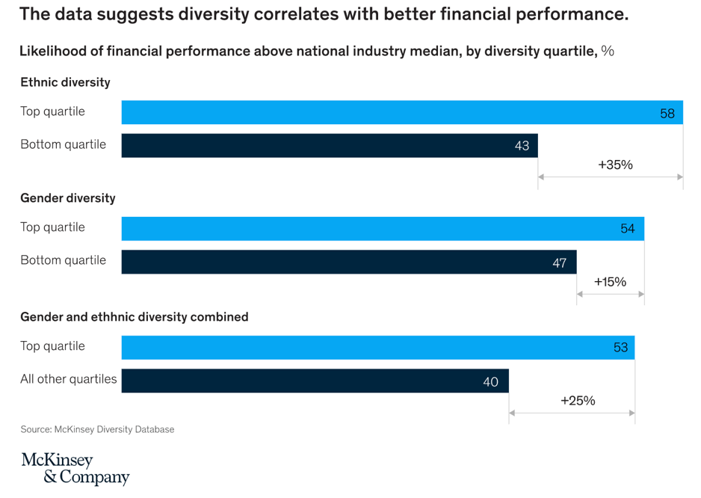
DEI Trends…why it matters
McKinsey study of 366 public companies, Diversity Matters, 2014
Companies in the top quartile for racial and ethnic diversity are 35% more likely to have financial returns above their respective national industry medians.
Companies in the top quartile for gender diversity are 15% more likely to have financial returns above their respective national industry medians (exhibit).
Notes:
KT

Slide 7
DEI Trends…why it matters
McKinsey study of 366 public companies, Diversity Matters, 2014
Here’s where it really gets interesting….
Companies in the bottom quartile both for gender and for ethnicity and race are statistically less likely to achieve above-average financial returns than the average companies in the data set (that is, bottom-quartile companies are lagging rather than merely not leading).
For every 10% increase in racial and ethnic diversity on the senior-executive team, earnings before interest and taxes (EBIT) rise 0.8%.
Racial and ethnic diversity has a stronger impact on financial performance in the United States than gender diversity, perhaps because earlier efforts to increase women’s representation in the top levels of business have already yielded positive results.
Notes:
KT

Slide 8
DEI Trends…where were we?
McKinsey study of 366 public companies, Diversity Matters, 2014
Achieving greater diversity is not easy…
Women—accounting for an average of just 16% of the members of executive teams in the United States, 12% in the United Kingdom, and 6% in Brazil—remain underrepresented at the top of corporations globally.
The United Kingdom does comparatively better in racial diversity, albeit at a low level: some 78% of UK companies have senior-leadership teams that fail to reflect the demographic composition of the country’s labor force and population, compared with 91% for Brazil and 97% for the United States.
So what has changed since 2015?
Notes:
KT

Slide 9
DEI Trends…where are we?
McKinsey study of over 1,000 companies, Delivering through Diversity, 2018
The relationship between diversity and business performance persists
The statistically significant correlation between a more diverse leadership team and financial outperformance demonstrated three years ago continues to hold true on an updated, enlarged, and global data set.
Leadership roles matter
Companies in the top-quartile for gender diversity on executive teams were 21% [up from 15% in 2015] more likely to outperform on profitability and 27% more likely to have superior value creation. The highest-performing companies on both profitability and diversity had more women in line (i.e., typically revenue-generating) roles than in staff roles on their executive teams.
It’s not just gender
Companies in the top-quartile for ethnic/cultural diversity on executive teams were 33% [down from 35% in 2015] more likely to have industry-leading profitability. That this relationship continues to be strong suggests that inclusion of highly diverse individuals – and the myriad ways in which diversity exists beyond gender (e.g., LGBTQ+, age/generation, international experience) – can be a key differentiator among companies.
Notes:
KT

Slide 10
DEI Trends…where are we?
McKinsey study of over 1,000 companies, Delivering through Diversity, 2018
There is a penalty for opting out
The penalty for bottom-quartile performance on diversity persists. Overall, companies in the bottom quartile for both gender and ethnic/ cultural diversity were 29% less likely to achieve above-average profitability than were all other companies in our data set. In short, not only were they not leading, they were lagging.
Notes:
KT

Slide 11
The DEI Difference
Moving the dial on DEI is challenging
These types of initiatives aren’t like other typical organizational initiatives.
DEI, on the other hand, is deeply personal.
There are more personal factors and individual choices around whether one buys into DEI’s foundational values.
Notes:
KT
These types of initiatives aren’t like other typical organizational initiatives. Take sales, for example. When a new set of targets or priorities roll out, sales leaders might get passionate to charge up the troops, but rarely does that passion strike a deeply seated personal chord.
DEI, on the other hand, is deeply personal. Sales incentives often take care of most sales initiatives, but an extrinsic motivator won’t spur changes as deeply seated as diversity, equity and inclusion.
There are more personal factors and individual choices around whether one buys into DEI’s foundational values. It may be a vitally important subject for one person while another may not see the urgency or even the need for change.

Slide 12
Organization Design
Notes:
SM

Slide 13
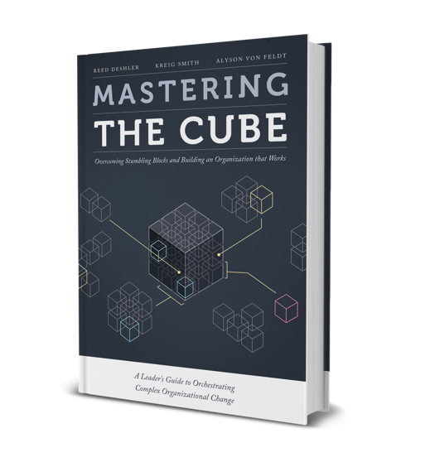
Organizations are Like Trying to Solve a Rubik’s Cube
We’ve outlined the method for solving the Organizational Cube in our book
Like a Rubik’s® Cube, Organizations can be aligned with the right process and tools
Notes:
SM
Key to all of this conversation is establishing a common language. Mastering the Cube is one way to set up that language

Slide 14
The Organization Design Model
Strategy
Capabilities
Choices
Environment
Results
Why will we be chosen over our competitors?
What work (capabilities) drives differentiation (the reason we are chosen)?
How do we organize to best leverage those capabilities?
Notes:
SM
We get our minds around it by using an organization design model (see MTC Chapter 1).
The Alignment Model starts on the right-hand side with “what are the results you are trying to achieve?” What are your current results and what is the gap?
Design then starts from the marketplace and work in.
Then consider you must consider the environment within which the results are occurring – position in marketplace, political atmosphere, competition etc.…. Can be both internal and external.
Based on those thing you develop a strategy which helps you understand how you are going to win in marketplace. When you win in the marketplace, your customers choose you over your competitors.
Once you understand your strategy, you determine which capabilities you required to execute your strategy.
After the strategy is understood and the capabilities determined you then need to make organizational choices that will best leverage your capabilities. Choices----these are all the choices you have to make to get the work in such a way that it aligns with your strategy. Lines of business are making choices to win in the marketplace. Support functions are making choices for how to enable the lines of business to achieve their objectives.

Slide 15
Philosophies
If you want to change the whole, you must change the whole – it is more than diversity training programs, the hiring process or a grievance system.
“Alignment is king” – The alignment of many choices has more impact on success than a handful of “best-in-class” but misaligned choices.
Culture is a cause and a result of design choices; thus, the best way to change culture is to change organization choices and leaders’ thinking.
High involvement and participation lead to the best choice making.
You don’t change organizations unless you change the way people think about how the organization competes and operates.
Notes:
SM &
Ken T
Talk about some of our philosophies and how they relate to DEI

Slide 16
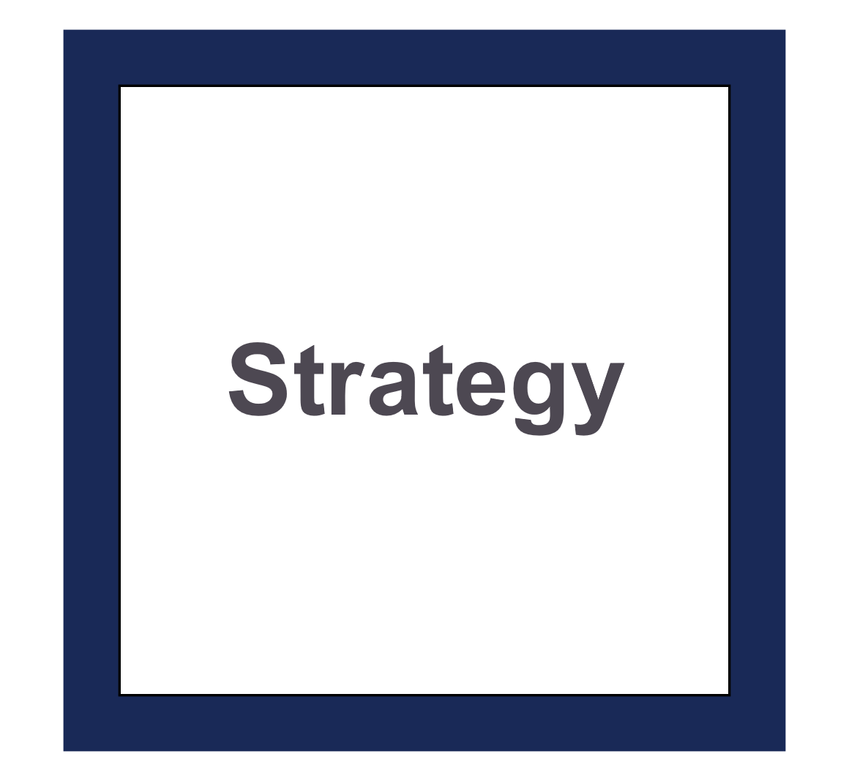
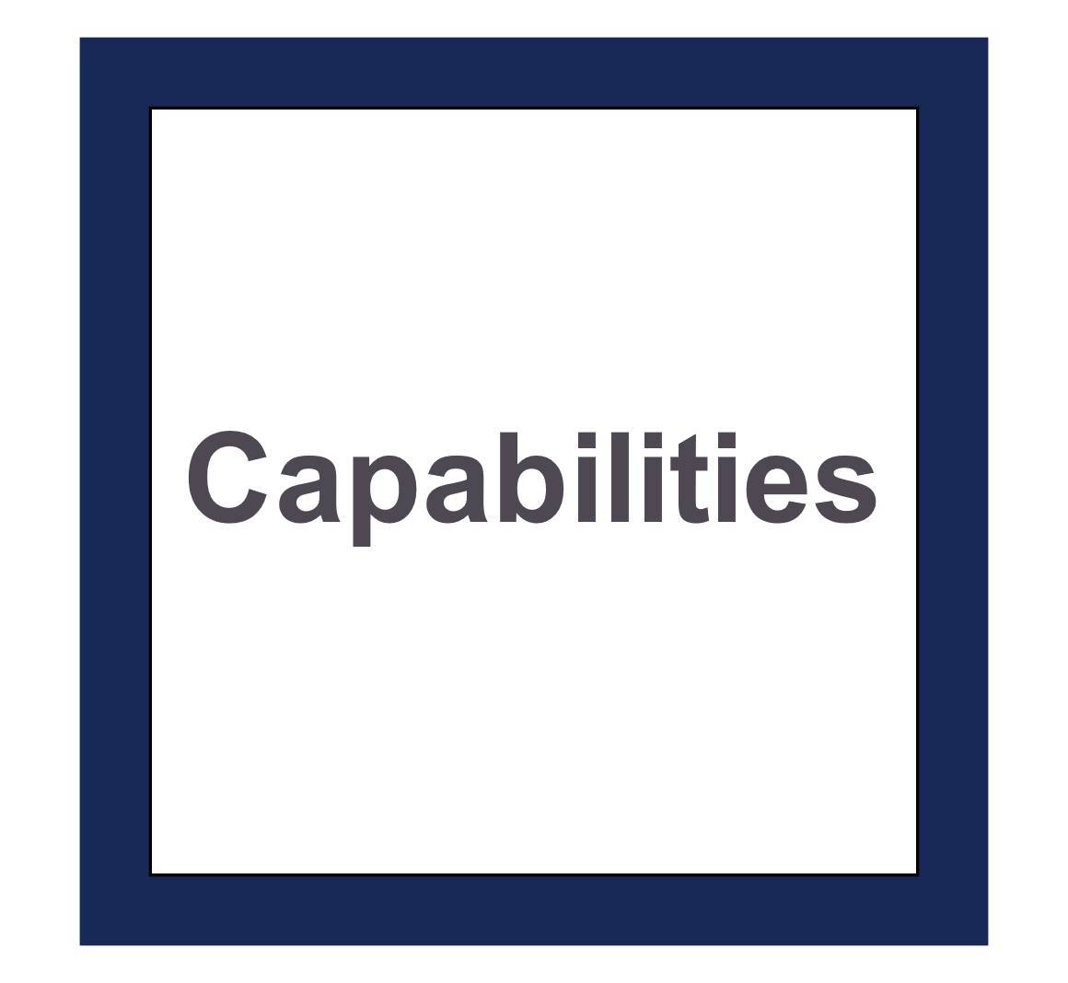
Enhancing Your DEI Culture: Where to Intervene?
Culture: Assumptions, beliefs, behaviors, norms
Organization Choices
Decision Making
(What and How)
Which in turn drives organizational choices
Organization culture is self-reinforcing and difficult to change.
Notes:
SM

Slide 17
Moving the Dial - Overview
DEI Stumbling Blocks and Building Blocks
Common DEI inhibiters: “Stumbling Blocks”
Common DEI enhancers: “Building Blocks”
3. Lack of Metrics
3. Data is King
4. “I can’t find anyone!”
4. Creativity
1. Diversity Saturation
1. Communi-cation
5. Reputation vs. Reality
5. People & Rewards
2. Myopic Solutions
6. Compulsory Training
2. Measure Progress
6. Reimagine Training
Notes:
KT

Slide 18
Poll # 1
Which of the following stumbling blocks is the most prevalent in your organization?
Diversity Saturation
Myopic Solutions/Approach
Lack of Metrics
“I can’t find anyone!”
Reputation vs. Reality
Compulsory Training
3. Lack of Metrics
4. “I can’t find anyone!”
1. Diversity Saturation
5. Reputation vs. Reality
2. Myopic Solutions
6. Compulsory Training
Notes:
KT

Slide 19
Moving the Dial on DEI
Benefit 1: Increased Speed in Decision Making
#1
DIVERSITY SATURATION
VS. COMMUNICATION
BENEFIT # 1
Increased speed in decision making
Notes:
SM
Diversity saturation: Employees get tired of constant diversity oversight, which can sometimes cause non-minority groups to feel excluded. If you are giving the impression of preferential treatment to minority groups, no one will believe that your organization has an environment where diversity, equality, and inclusion exist naturally and in harmony.
Communication: Walk the walk and talk the talk. Openly and authentically discuss the value diversity has brought to your organization. Clearly communicate the advantages of a diverse workplace in a meaningful way, watching for opportunities to point out how a more diverse team has enhanced the overall capabilities of the organization.

Slide 20
1. Diversity Saturation vs. Communication
Diversity saturation: Overemphasis on compliance
Don’t aggravate the issue: Be cognizant of the perception of preferential treatment
Communication: Walk the walk and talk the talk. Openly and authentically discuss the value DEI brings to your organization
Forums and focus groups – equip managers to have conversations to make this relevant
Link to Strategy:
Explain how your DEI initiates will drive the organization’s growth strategy
Do this with data (more on this later)
Notes:
SM
Stumbling:
Diversity saturation. Employees get tired of constant diversity oversight from a compliance enforcement perspective.
Don’t aggravate the issue. If you are giving the impression of preferential treatment to minority groups, no one will believe that your organization has an environment where diversity, equality, and inclusion exist naturally and in harmony.
Building:
Communication. Walk the walk and talk the talk. Openly and authentically discuss the value diversity has brought to your organization. Clearly communicate the advantages of a diverse workplace in a meaningful way, watching for opportunities to point out how a more diverse team has enhanced the overall capabilities of the organization.
Link to Strategy. Explain how your DEI initiates will drive the organization’s growth strategy. Do this with data (more on this later).

Slide 21
Moving the Dial on DEI
Benefit 1: Increased Speed in Decision Making
#2
MYOPIC SOLUTIONS
VS.
MEASURING PROGRESS
BENEFIT # 1
Increased speed in decision making
Notes:
KT
Common myopic solutions: We see this when an organization decides to promote (or hire) the next available minority individual. It ought to be obvious that this “solution” will only engender resentment among other team members. Promotions should still be based on a blending of performance and potential, but the key is ensuring fairness and to eliminate bias from this process (we’ll address more of this is the steps below).
Measure Progress: Data is key – you can’t improve what you don’t measure. What are the DEI metrics in your organization, and how do they compare to the workforce population in your geography? Are you using your data to drive action?

Slide 22
2. Myopic Solutions vs. Measuring Progress
Hiring the first available DEI candidate (over better qualified candidates):
Engenders resentment
Breaks down trust and confidence
Performance and Potential:
Ensures fairness (usually)
Data and metrics driven
Measuring potential is key
These are organizing choices…
Remember, diverse teams are 35% more likely to have industry-leading profitability (McKinsey, 2018)
Notes:
KT
Building:
Hiring the first available DEI candidate (over better qualified candidates).
Engenders resentment
Breaks down trust and confidence in your talent management team and processes
Stumbling:
Performance and Potential.
Ensures fairness (usually)
Should be data and metrics driven
Look at how you measure potential as a key opportunity to capture diversity of thought in your organization
These are organizing choices…
Remember, diverse teams are 35% more likely to have industry-leading profitability (McKinsey, 2018)

Slide 23
Moving the Dial on DEI
Benefit 1: Increased Speed in Decision Making
BENEFIT # 1
Increased speed in decision making
#3
LACK OF METRICS
VS.
DATA IS KING
BENEFIT #2
BETTER EMPLOYEE ENGAGEMENT
Notes:
SM
Lack of standardized data and metrics: When standardized measurement tools and information are not embedded into talent acquisition and management activities, that lack of uniform measurement and reporting will ensure that DEI initiatives are not universally followed.
Data: Help hiring and selecting leaders make the best decision for the organization by hiring the most qualified candidate while at the same time ensuring it is done without bias. For example, many organizations sterilize applicant data on the initial screening process from all terms that denote race, gender, age, etc. It is also a good practice to have the relevant metrics involved in the process to ensure your organization is looking at an adequate representation of available DEI candidates for that skillset and geographical area.

Slide 24
3. Lack of Metrics vs. Data is King
Reporting: “If you’re not reporting it, then it’s not important!”
Accountability: Are leaders held to DEI metrics?
Baseline: Lack of data to denote your organization with local geography
Best hiring practices:
Sterilize discriminatory data
Current organization composition
Measure your efforts:
Measure
How do we measure inclusion?
What are leading indicators and lagging indicators?
How do we measure diversity in different countries (example: Japan vs USA)
Notes:
SM
Stumbling:
Lack of standardized data and metrics: When standardized measurement tools and information are not embedded into talent acquisition and management activities, that lack of uniform measurement and reporting will ensure that DEI initiatives are not universally followed.
Building:
Data: Help hiring and selecting leaders make the best decision for the organization by hiring the most qualified candidate while at the same time ensuring it is done without bias. For example, many organizations sterilize applicant data on the initial screening process from all terms that denote race, gender, age, etc. It is also a good practice to have the relevant metrics involved in the process to ensure your organization is looking at an adequate representation of available DEI candidates for that skillset and geographical area.

Slide 25
Moving the Dial on DEI
#4
“I CAN’T FIND ANYONE”
VS.
CREATIVITY
Notes:
KT
“I can’t find anyone”: If your talent acquisition methods are weak, the DEI recruiting results will likely be lackluster as well. If you hear this excuse, it may be time for a deep dive on why your organization struggles to attract or develop diverse candidates. Leaders might say all the right things, but whether behaviors and practices have really changed is still highly visible to the team. Keep in mind that “if you want something new, you have to stop doing something old” (Peter Drucker).
Creativity: Become inventive with attracting and recruiting diverse candidates. Have you considered non-traditional recruiting channels, such as veterans, technical certificate holders, career switchers, community colleges, or events and sponsorships that cater to minority interests? How flexible could you get with scheduling options to attract more stay-at-home or returning-to-work parents?

Slide 26
4. “I Can’t Find Anyone!” vs. Creativity
Talent acquisition capabilities:
If these are weak, your DEI recruitment will be lackluster
Look at your current practices:
Screening and hiring process (including automated ones)
Metric and data supported?
Create specific DEI initiatives:
DEI initiatives aligned to enable strategy
Invest in DEI initiatives
Consider non-standard recruiting channels
Incentivize behaviors that reinforce DEI capabilities
Create Employee Resource Groups (ERGs).
“If you want something new, you have to stop doing something old” (Peter Drucker).
Notes:
KT
Stumbling:
Building:
Create specific DEI initiatives.
DEI initiatives should be developed based on your strategic growth opportunities
Invest in DEI initiatives. Particularly those that enable the
Initiatives in pursuit of the I&D goals should be targeted based on growth priorities, and investments made to both hard- and soft-wire the programs and culture of inclusion required to capture the intended benefits.
Create Employee Resource Groups (ERGs).
Conduct periodic pulse surveys.
(Become inventive with attracting and recruiting diverse candidates. Have you considered non-traditional recruiting channels, such as veterans, technical certificate holders, career switchers, community colleges, or events and sponsorships that cater to minority interests? How flexible could you get with scheduling options to attract more stay-at-home or returning-to-work parents? ) Example: service now

Slide 27
Moving the Dial on DEI
Benefit 1: Increased Speed in Decision Making
#5
REPUTATION & REALITY
VS.
PEOPLE & REWARDS
Notes:
SM
DEI reputation and reality: Do diverse candidates get a positive impression when they interact with your company? Do not pretend your company is something it is not. Your company DEI culture cannot be disguised by crafty seating charts and bribed or forced employee reviews.
People and Rewards: Reward those with hiring responsibilities for successful efforts to improve DEI. As leaders define (by example) what behaviors are needed to amplify a good DEI culture and what behaviors need to be diminished to improve DEI, your organization can create synergies around a diverse workforce.

Slide 28
5. Reputation & Reality vs. People & Rewards
What is reality?
What DEI signals is your organization emitting?
How are DEI indicators visible in your organization?
Leaders’ role: Identify practices and behaviors which strengthen DEI and which detract.
What are your shared assumptions, beliefs, behaviors, and norms of the workforce?
Leadership behavior exerts a strong force on culture.
Inadequate leadership traits can become liabilities when advancing the DEI cause.
Commitment and follow through: Embed DEI enhancing capabilities to reinforce your strategic initiatives; Reward those the further DEI initiatives
Accountability: Hold leaders accountable for implementing DEI initiatives, measured using objective data; When incentives change, behaviors change
Notes:
SM
Stumbling:
What is reality? Take an honest look at your organization.
What DEI signals is your organization emitting?
How are DEI indicators visible in your organization?
Leaders’ role. Identify practices and behaviors which strengthen DEI and which detract.
What are your shared assumptions, beliefs, behaviors, and norms of the workforce?
Leadership behavior exerts a strong force on culture.
Building:
Commit and follow through. Leaders should embed DEI into the corporate strategy and how it supports the organization’s vision.
Accountability. Hold leaders accountable for DEI initiatives, measured using objective data. When incentives change, behaviors change.
When leaders are passionate, enthusiastic, communicate effectively and spend time working with teams, people perceive the importance of the DEI initiative to the organization and its stakeholders.
However, when those positive tendencies are absent, the lack of support is equally evident. Inadequate leadership traits can become liabilities when advancing the DEI cause. Such leaders are perceived as not being on board with the initiative or not fully committed to the objectives and the ultimate outcome.

Slide 29
Moving the Dial on DEI
#6
COMPULSORY TRAINING
VS.
REIMAGINE TRAINING
Notes:
KT
Compulsory DEI training: Compulsory training has been proven to generate fear, and it does not move the needle. In fact, in many cases, this generates negative bias and creates a larger gap in the organization’s DEI.
Re-Imagined Training: Voluntary training works best, particularly if the organization can provide a forum for interesting and compelling discussions (everyone has a story). Encourage voluntary participation and find opportunities to utilize voluntary trainers pulled from the ranks of your diverse workforce.

Slide 30
6. Compulsory Training vs. Reimagine Training
Compliance training:
Fear
Informs, but doesn’t move the dial
Negative bias
Reimagine your training:
Volunteers
Forums
Compelling dialogue
From all ranks of the organization
Collaborate and have fun
Others from our audience? (drop your comments in Q&A)
Notes:
KT
Stumbling:
Compulsory DEI training: Compulsory training has been proven to generate fear, and it does not move the needle. In fact, in many cases, this generates negative bias and creates a larger gap in the organization’s DEI.
Building:
Re-Imagined Training: Voluntary training works best, particularly if the organization can provide a forum for interesting and compelling discussions (everyone has a story). Encourage voluntary participation and find opportunities to utilize voluntary trainers pulled from the ranks of your diverse workforce.

Slide 31
Poll # 2
Which of the following building blocks will have the greatest positive impact in your organization?
Communication
Measure Progress
Data
Creative Recruiting
People & Rewards
Reimagine Training
3. Data is King
4. Creativity
1. Communi-cation
5. People & Rewards
2. Measure Progress
6. Reimagine Training
Notes:
KT

Slide 32
Questions
Type your question in the Q&A box
Notes:
SM introduce slide
Both SM and KT answer questions as needed

Slide 33
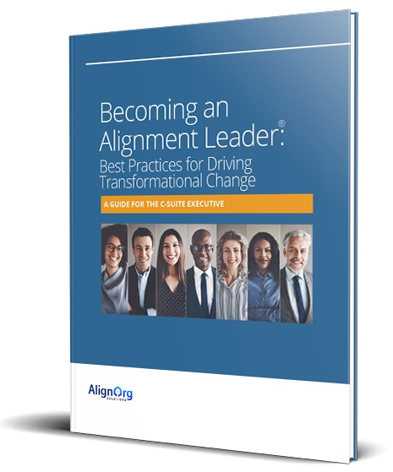
Becoming an Alignment Leader®
Best Practices for Driving Transformational Change
Learn how to sponsor and lead change in your organization
Consider trade-offs and choices
Drive change effectively – have the right conversations with the right people at the right time
Build “Alignment” capabilities
How to work with other change partners in your organization
Watch your email for a link to download a copy of this practical guide
Notes:
SM

Slide 34
AlignOrg Solutions
Ken Thompson
Sharon Moura
ken.thompson@alignorg.com
www.alignorg.com
sharon.moura@alignorg.com
www.alignorg.com
Notes:
SM

