Slide 1
How To Organize For A Differentiated B2B Customer Experience
Doug Von Feldt & Sharon Moura

Slide 2
Business Buyer Expectations Mirror Growing Consumer Expectations
Customers’ expectations for empathetic and personalized engagement don’t stop when they go to work. Much like consumers, business buyers see a gap between their expectations and the reality they experience.
< 50%
2/3
70%
76%
84%
91%
Average B2B CX score
Companies compete on CX
Enterprise CEOs see UX & CX as a differentiator
Will switch to a competitor after one bad experience
Say experience is as important as product or service
Are likely to repeat purchase after a positive experience
*Inceptresults.com
*McKinsey & Company
*Fullstory.com
*Acquia.com
*Userzoom.com
*State of the Connected Customer, Oct ‘20

Slide 3
Is and Is Not
A differentiated customer experience IS…
One that distinguishes your organization from the competition
One that your customer’s value and is a reason they choose you
A differentiated customer experience IS NOT…..
Delighting the customer at every interaction
Focused only on customer service
A differentiating customer experience is often described as “amazing” or “best in class.” If your organization provides a uniquely compelling experience and attracts new customers, it’s likely a differentiating customer experience.

Slide 4
Your Customer’s Journey Matters
Built from customer data and insight
Always from the customer’s perspective
Used to design the experience for the customer’s desired journey
Explore
Evaluate
Purchase
Install
Operate
Discover
Select
Onboard
Use
Advocate
Attract
Convert
Nurture
Close
Service
Simplified Illustrations

Slide 5
Where will an “at par” CX will be ok?
It depends….
Research
Innovate
MFG
Sell
Distribute
Notes:
Custom verses commodity
DuPont has a presence in over 70 countries, with headquarters in Wilmington, Delaware, and operates approximately 170 manufacturing sites, over 10 global R&D centers and 10 global innovation centers. DuPont (NYSE: DD) is a global innovation leader with technology-based materials, ingredients and solutions that help transform industries and everyday life. Our employees apply diverse science and expertise to help customers advance their best ideas and deliver essential innovations in key markets including electronics, transportation, construction, water, health and wellness, food, and worker safety. More information can be found at www.dupont.com
Noah Chemicals: MISSION STATEMENT
We Enable the World’s Greatest Innovations!
Established and reliable, Noah Chemicals is your single source for both traditional and custom chemical products. Whether you are in need of a regularly produced inorganic compound or a rare or custom-manufactured chemical, Noah Chemicals has the facilities and the expertise to meet your requirements.

Slide 6
Where a differentiated B2B CX will help your organization win
It depends… some customer touch points have greater strategic value than others.
Explore
Evaluate
Purchase
Install
Operate
Life Sciences Manufacturer
Building Equipment Manufacturer
Healthcare Product Manufacturer
Software-as-a-Service Provider
Telecom Provider
Identify your customer’s critical moments before you begin to deliver a strategic differentiated B2B experience.
Notes:
Life Sciences Manufacturer - Scientist to scientist pre-sales
Building Equipment Manufacturer - Product configuration
Healthcare Product Manufacturer - Ecommerce (Small Distributor), Relationship management (Large Distributor)
Software-as-a-Service Provider - Communities of experts, partner ecosystem, citizen developer training
Telecom Provider - Easy to understand billing

Slide 7
Customer Segmentation Matters
There are many ways to segment customers. This organization looked at how customers wanted to interact with them
Minimum Touch | Emerging | White Glove
Product information Digital interaction Live person via phone Content library | Single point of contact Inside sales contact General marketing insights Forecasting support Help driving end user demand Business generation Flexibility, agility Proactive recommendations based on prior behavior Portal access for information | New idea collaboration High-touch partner collaborator Forecasting Channel Manager interaction Interaction with sales organization Dedicated account team Customized insights Proactive solutions to issues Quarterly joint planning POS data analysis System integration

Slide 8
Customer Segmentation
Customer 1
Tier 1
Tier 2
Tier 3
Customer 2
Customer 4
Revenue Goals
Increasing level of attention and deliverables
Customer 3
Customer Desired Interaction
 | Minimum Touch | Emerging | White Glove
Number of Customers | High | Med | Low
Dollar Value | Low | Med | High
Staffing Number | Low | High | Medium
Primary Transaction | Web-store | EDI | EDI
Digital Experience
Customized Experience

Slide 9
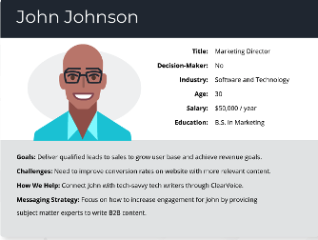
B2B Personas Matter
Who are the customer personas that matter for your organization?
Service Technician
I want to show up as a professional. Make it easy for me to be a professional on servicing your products.
Purchaser
I am busy; it needs to be frictionless to buy from you.
CEO
Reduce my investment risk. I want to know I am partnering with innovative winning companies.
HR Leader
Teach me to fish. Show me how to identify OD needs and solve for them.

Slide 10
What are the organizational implications of your choices?
Customer Insight
Model for Organizational Implications
Customer Journey Map
Customer Segmentation
Personas That Matter Most
Notes:
The purpose of organization redesign is to achieve new or better results
Develop your strategy based on the customer needs that you are designing the organization to fulfill. For example, fewer touch points, simpler payment options, better support, faster delivery, or more product options. Whatever the answer, it’s important to remember that organization design should start outside and work in.

Slide 11
Alignment is King
”The alignment of many choices has more impact on success than a handful of “best-in-class” but misaligned choices.”
Areas for Alignment | Key Questions | Organization Implication Examples
Strategy | How does this insight inform how your organization will win in the marketplace? What capabilities are differentiating? | Billing, typically a necessary function, becomes a competitive differentiator
Work | What work will change as a result? What is the strategic impact of the work? How will you re-imagine work processes that impact the customer? | Ensure journey maps reflect all work required to create a create customer experience, not just customer facing work
Structure & Linkages | How will you align that work to a structure? | New Customer Experience organization for “White Glove & Emerging” customers aligned by geography and customer type
Information & Metrics | How will you measure effectiveness of the organization? | Shift from customer service metrics to customer experience metrics
People & Rewards | How will you allocate staff? What type of talent do you need and how will they be rewarded? | Highly skilled PHD’s may be required to take service calls to resolve issues quickly
Leadership & Culture | How will this change the leadership you hire and how they behave? What organizational choices will you make to create the culture you need for success? | Every leadership meeting starts with a customer story. Leaders actively sponsor a customer account.
Notes:
TIPS FOR LEADERS TO CONSIDER
Work Activities/Processes: If the work doesn’t change, the results don’t change. As organization leaders adjust or change strategy, scrutinize the work of the organization and discern what new or existing activities and touch points will actually deliver differentiation in the marketplace. Look for ways to deliberately design your organization work activities and processes to manage both the competitive and the “running the business” work so
2 that the day-to-day necessary work does not overrun the competitive work.
Organizational Structure: If the customer experience is to be one of your organization’s competitive advantages, then organization structure choices must reflect the customer experience as a top priority. This can be accomplished by ensuring your organization’s structure is deliberately designed to deliver on the capabilities needed to effectuate a
3 differentiated customer experience.
Data and Metrics: Utilize data and metrics to determine whether your customer experience is improving or declining. Organizations should seek to get actionable data that is accurate, relevant, and timely into the hands of leaders on the front lines, where it will be employed to effectively identify and solve problems and optimize the customer
4 experience (discussed further in Chapter 5).
Decision Rights: Adjust decision rights, if necessary, to protect the customer experience without assuming unnecessary risk. For example, a car dealership that cultivated particularly loyal customers authorized the service team to prioritize and adjust service schedules to meet customers’ specific individual needs. Empowered customer- facing employees are key to creating a positive customer experience with no friction throughout the customer journey.
5 Incentives and Training: Leaders are responsible to ensure that high-quality, consistent training opportunities are provided for customer-facing employees, recognizing that a
6 highly skilled team will decrease customer churn and improve the company’s reputation.
Technology: Explore new ways to use technologies and digitization with voice of the customer (VOC) and customer feedback as a roadmap to guide how you manage these new choices. These capabilities will provide valuable business insights to help your organization improve and differentiate the customer experience.
0 A word of caution: Empowering employees requires the applicable SOPs, clearly defined decision rights, and processes or play books to be in place to mitigate risk and ensure optimal outcomes and consistency.
14 Designing an Organization for a Differentiated Customer Experience
Many business leaders say they believe having loyal customers is key to business success; however, not all are willing to invest in the capabilities and organization design framework necessary to achieve a truly differentiated customer experience. Business systems, processes, and other strategic choices must be aligned and focused on delivering the critical capabilities to support a differentiated customer experience. Your organization should ensure that all aspects of the “organizational cube” are aligned with your strategy and capabilities.

Slide 12
Culture
“The secret of success is changing the way you think.”
- Jack Welch
Customer-First Culture
Culture of Customer Care
Get off the PowerPoint and into Action
Customer Centric Culture
Culture of Customer Intimacy
Culture is a cause and a result of design choices; the best way to change culture is to change:
Organization choices, and
Leaders’ thinking & behaviors
Notes:
Leaders must be committed to the cause and that should be reflected in their prioritization of efforts, communication, resourcing, and follow- through.

Slide 13
Four Steps to Differentiated Customer Experience
“You don’t change organizations unless you change the way people think about how the organization competes and operates.”
1
Strategy Alignment: Ensure customer experience is built into the strategy and is a true differentiator in practice and not just in words.
Deeply Understand the Customer: Allocate the expert resources and do the in- depth research.
Organizational Alignment: Use a high involvement approach with a cross functional team to design your organization for a differentiated experience.
Insight to Innovation: Implement a business model that continuously learns about the customer, generates new meaningful insights and turns them into action.
2
3
4
Notes:
In-Depth Research: What do your customers value in their interactions with your company? Identify needs by conducting in-depth research and asking customers specific questions about their problems. Gathering these details allows a better understanding of your customers and their value points.
Organizational Alignment: Align your work activities, reward systems, metrics, culture, and structures to this strategy and operating model. This isn’t a quick shuffling of the org chart, rather a thoughtful (and sometimes ongoing) effort to align the organization and related processes, systems, structures, metrics, rewards, and talent.
Innovation: Keep an eye on future trends to help you anticipate needs – and prepare to offer as soon as they need it. A business model that delivers the right innovation by correctly identifying customer wants and needs will gain customers, sell more products and services, and generate a loyal following.

Slide 14
In Closing…
True organization alignment enables customers to consistently feel your distinctive offering at critical moments – and differentiates your organization from the other noise in the marketplace.
Notes:
.

Slide 15
Thank you!
Sharon Moura
Doug Von Feldt
772-214-7282 (M)
Sharon.Moura@alignorg.com
www.alignorg.com
785-393-4508 (M)
Doug.VonFeldt@alignorg.com
www.alignorg.com
Notes:
Todd

Slide 16
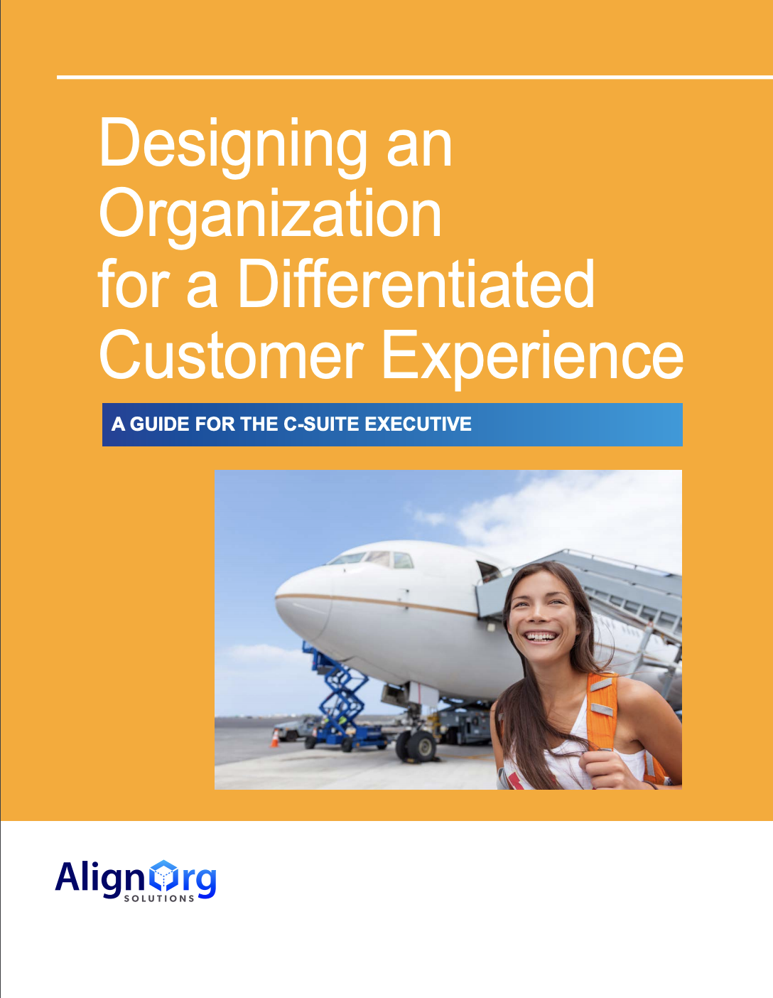
Continued Learning: AlignOrg Solutions’ CX Executive Guide
Use the customer experience as a competitive advantage
Discover if a differentiated customer experience is a winning strategy for your organization
Measure how customer experiences help your organization succeed
Watch your email for a link to download a complimentary copy
Notes:
KT

